Slide 1



COPILOT ACCELERATION TEAM
Building an AI-ready organization

Slide 2

Summit Bajracharya
Solution Architect

Slide 3
About Signetic
Seattle based Healthcare Technology Company
HIPAA-compliant, cloud-hosted platform modernizing pharmacy and clinic operations
Modular, extensible platform with mobile and web-based applications for end-to-end pharmacy operations
Proven at scale: supported 800,000+ patients at Seattle’s Lumen Field mass-vaccination site during COVID-19
Helps pharmacies and clinics become modern community health hubs — from scheduling to billing to AI-powered claims processing
2016
Founded — mission to eliminate paperwork and help customer in digital transformation
2022–23
Enterprise platform: scheduling, billing, reporting. Power Automate + Power BI added
2020
COVID pivot: mass vaccination at Lumen Field (800K+ patients). Power Apps + Dataverse deployed at scale
2024–Now
Copilot Studio AI agents live. Dedicated AI team formed. MCP + Dataverse powering autonomous workflows

Slide 4
The Problem: Before Signetic
❌ BEFORE
✅ AFTER: Signetic
Patients fill out paper forms by hand at every visit
Staff manually transcribe records — lines out the door, hours of backlog
Immunization records missing 24hr reporting deadlines
Claims billing: manual, error-prone, slow reimbursement
Prior authorizations: weeks of back-and-forth with insurers
No scale — couldn’t grow without adding more manual labor
Patients self-register via QR code — no clipboards, no lines
Staff use canvas apps — real-time, digital, zero transcription backlog
Auto IIS submission — immunization records filed within minutes
AI Billing Ops Agent resolves claims errors in natural language
Prior Auth Agent sends forms autonomously — end-to-end, no human touch
Scaled to 800K+ patients — without adding headcount

Slide 5






AI enablement strategy and adoption journey
How we brought billing operators and pharmacy staff from zero to autonomous AI agents — in two lanes
DEV JOURNEY
1. Identify
Map painful workflows with staff
2. Build Agent
Copilot Studio + Dataverse MCP
3. Prompt + Test
Model eval with real claim data
4. Deploy Live
Embedded in Power Apps
↓ Handed to users
USER ADOPTION
Billing Operators
Pharmacy Staff
A. Awareness
Live demo of agent solving real claim error
B. Guided Practice
Side-by-side walkthrough with dev team
C. Daily Use
Staff request next agent themselves

Slide 6
AI enablement strategy and adoption journey
The Strategic Pillar we have adopted.
1 The Value Hypothesis
2 Co-Creation Framework
3 Workflow Ecosystem
4 Adopt
Audit time + pain
Sit with billing ops and pharmacy staff. Time every manual task.
Find the target
Same task every day? Manual copy-paste? That's just how we do it? That's your first agent.
Our pick: Prior Auth
2 hrs per case. Manual. Hated. Perfect first target.
Frontline users first
Job-shadow billing ops. Run prototype reviews with pharmacy leads.
Name champions
Internal champions co-own the rollout. Their word carries more weight than any IT memo.
Shape every prompt
Staff told us what 'a good answer' looks like. They caught edge cases we'd never find in testing.
Role-specific tools
Billing ops: model-driven app + embedded Copilot Studio agent. Pharmacy: canvas app.
Agent in the workflow
Embedded inside the app they already use. No new tab. No context switch.
Dataverse MCP
Real-time patient lookups with zero custom API code.
Structured rollout
Wk 1: Live demo -> Wk 2–3: Guided use -> Wk 4+: Independent use
Measure weekly
Track agent usage and error rates. Treat adoption like a project.
Show, don't mandate
Resistance drops when users see it work on their own claims.

Slide 7



How We Enabled AI: Our Technology Stack
USER LAYER
CORE PLATFORM
INTEGRATIONS & MONITORING
👤
🌐
☁
🏛
Patient
Patient Portal
Azure App Svc
Dataverse
SQL Server
CDC
Browse & Schedule
+ Portal API
API Gateway
Central Data Store
Reporting / Analytics DB
Disease Control
⚕
🔗
Staff
Power Apps
Power Automate
Azure Functions
Third-party
View & Fulfill
Canvas & Model
Workflows
Serverless
External Services
🏥
🔌
📈
⛓
Manager
Dataverse Plugins
Azure Svc Bus
Power BI
Log Analytics
Logic Apps
Locations & Setup
Custom Logic
Messaging
SQL Pipeline
Azure Monitor
Orchestration
💳
🔍
Billing Ops
Copilot Studio
Dataverse MCP
App Insights
Manage Billing
AI Assistant
Central Data Store
Telemetry
Data / Core
Azure Services
Power Platform
Data Pipeline
Gov / External
signetic.com

Slide 8





Agents that enhance claims processing
USER LAYER
Power Apps
KNOWLEDGE SOURCES
👤
Dataverse
Power Point
PDF
Pharmacy/Providers
Billing Ops Agent
Initiates Prior Auth Request via email or Chat
Copilot Studio
AI Assistant
💳
Billing Ops
Prior Auth Agent
Manage Billing
Outlook Connector
Azure Svc Bus
Dataverse MCP
Interaction between agent
and user
Messaging
Central Data Store
signetic.com

Slide 9
Agent Deep-Dive: Billing Ops Agent
What it does
Conversational agent embedded inside our billing model-driven app. Billing operators chat with it in natural language to resolve claim errors — without querying databases directly.
What it replaced
Manual error lookup — operators used to dig through error codes and documentation. Now they just ask the agent.
Result
Claims processed faster, errors fixed efficiently, operators focus on high-value tasks
HOW IT WORKS
1
Operator opens claim with error
KNOWLEDGE SOURCES
Dataverse claim records
NCPDP error code docs
Billing portal navigation guide
Internal SOP documents
2
Asks agent: “Why was this rejected?”
3
Agent queries Dataverse in real-time
4
Returns diagnosis + step-by-step fix

Slide 10
Agent Deep-Dive: Prior Authorization Agent
What it does
Fully autonomous agent — triggered by patient email. Verifies identity, retrieves appointment data from Dataverse via MCP, generates a completed prior auth form, and emails the insurer. Zero human touch.
What it replaced
Staff manually collecting patient info, filling forms, and chasing insurance companies — days of back-and-forth.
Key tech
Copilot Studio + Dataverse MCP Server for real-time patient lookup without API calls
AUTONOMOUS WORKFLOW
1
Users emails prior auth request for a service
2
Agent verifies name + DOB (requests if missing)
4
Generates completed prior auth form
3
Queries Dataverse MCP for patient + appointment
5
Emails completed form to insurance
fully autonomous, end-to-end

Slide 11
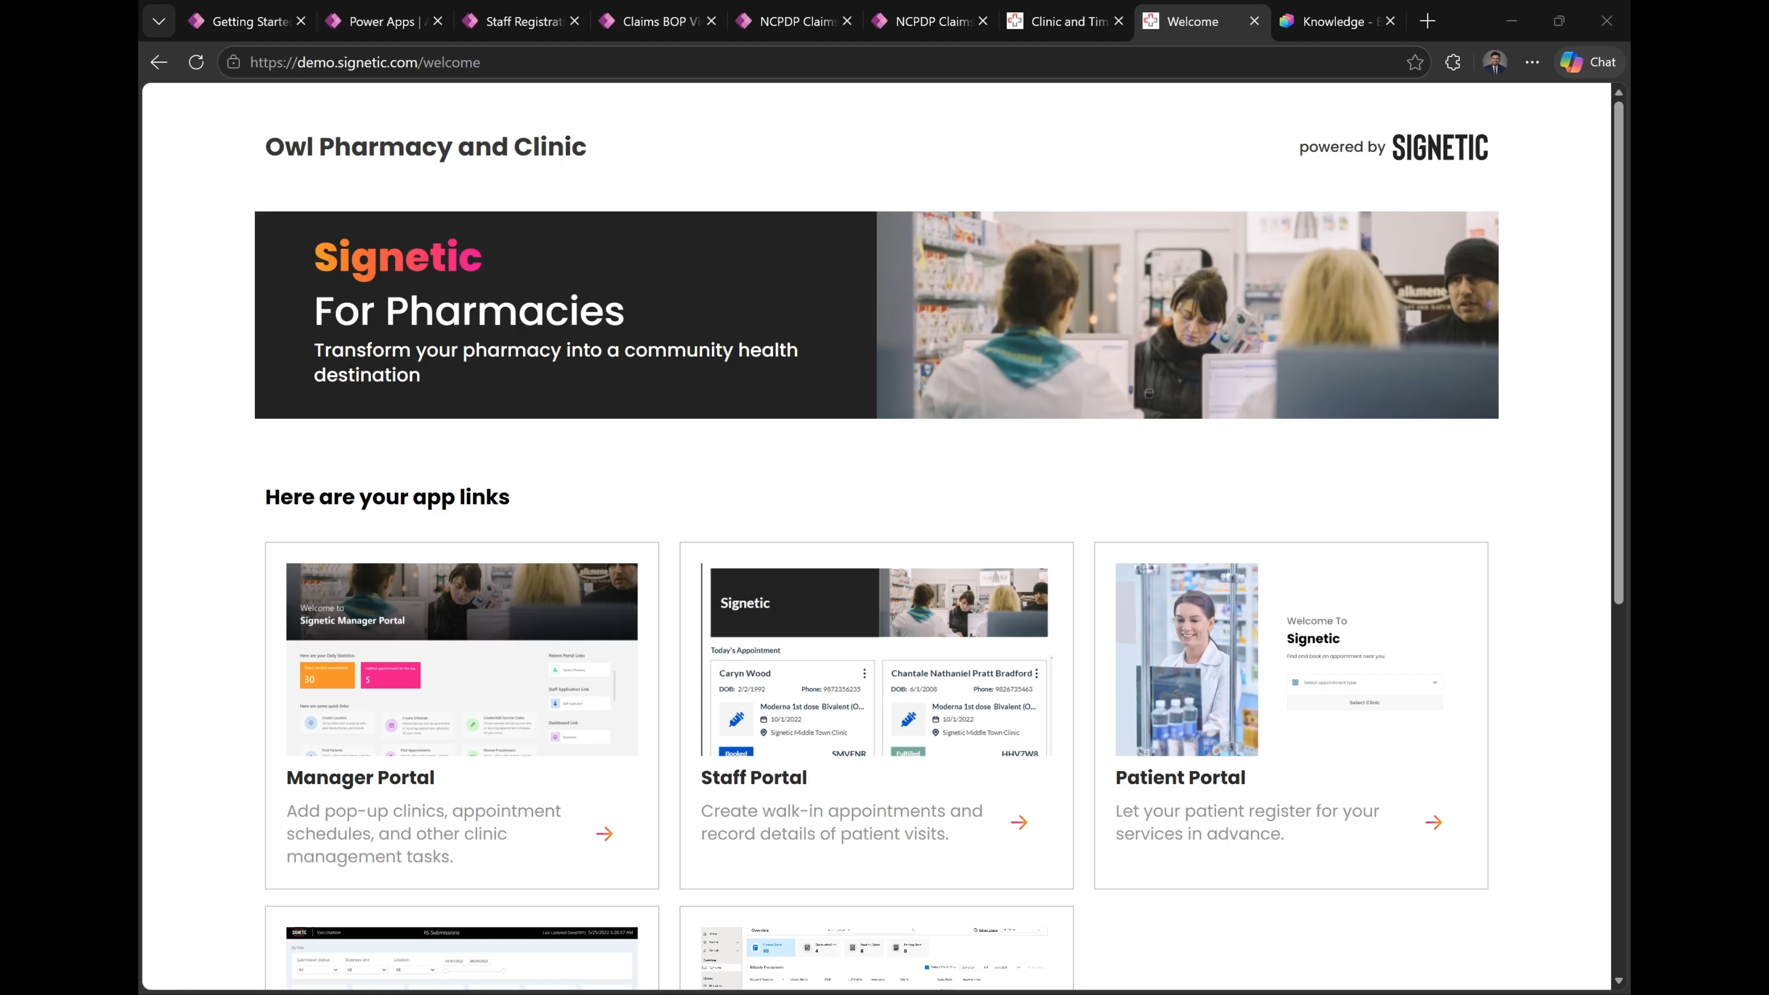

Slide 12

Key Takeaways
Our step-by-step playbook — what worked for us bringing AI to pharmacy and billing operations
1
Audit where time is actually going
What to look for:
Tasks done the same way every day • Manual copy-paste between systems • “That’s just how we do it here” workflows
We sat with billing ops and pharmacy staff and timed every task. Prior auth took 2 hrs per case. That’s where we started — not where IT told us to.
2
Engage frontline users before you build
How we did it:
Job-shadow sessions with billing team • Prototype review with pharmacy leads • Named internal champions who co-owned rollout
Billing operators told us what a good answer looks like. Pharmacy staff flagged edge cases we’d never catch in testing. Their input shaped every prompt.
3
Build role-specific tools — not one size fits all
Adoption tip:
Embed the agent inside the app they already use — don’t ask users to switch tabs or learn a new tool. Resistance drops to near zero.
Billing operators got the model-driven app + AI agent. Pharmacy staff got the canvas app. Different tools, same platform.

Slide 13
Key Takeaways (continued)
Steps 4 & 5 — making AI stick and scaling what works
4
Make adoption a structured process, not an afterthought
Our adoption milestones:
Week 1: Live demo with real claims • Week 2–3: Guided use alongside trainer • Week 4+: Independent use • Month 2: Users request next agent
We ran demo sessions, did side-by-side walkthroughs, and measured usage weekly. Adoption didn’t happen by itself — we treated it like a project with milestones.
5
Let success pull adoption — show, don’t mandate
The AI team’s ongoing job:
Monthly prompt reviews with users • Track agent usage + error rates • Discover next automation target • Never stop asking “what’s still painful?”
After prior auth went live, pharmacy staff asked ‘can it do eligibility checks too?’ We never had to sell the next agent. Word spread. Build something undeniably useful and adoption follows.
Audit → Engage Users → Build Role-Specific Tools → Drive Adoption → Let Results Pull the Next Wave

Slide 14

Speakers
Kaushik S
Manager, Intelligent Automation

Slide 15


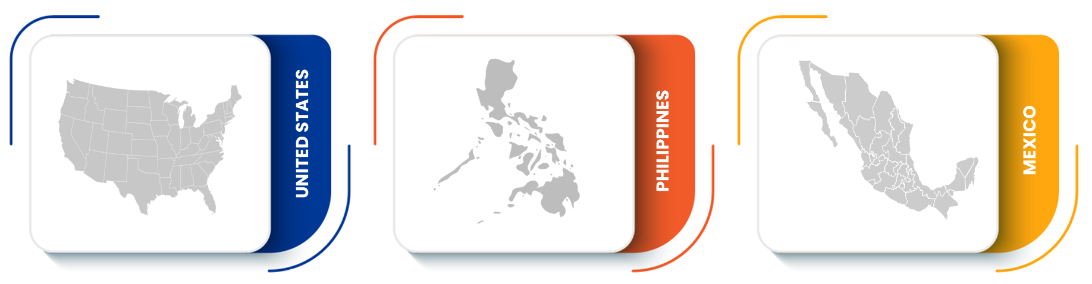

OUR SOLUTIONS
LEADER TENURE
We deliver comprehensive customer lifecycle engagement solutions.
Working together for better outcomes
23
12
years
years
12k
30
Industry experience in senior leadership
Average tenure with Afni
in senior leadership
+
+
Afni is a privately-held customer engagement company established in 1936, committed to building long-term partnerships rooted in trust and results. ​
​
Our performance, innovation, relationship-based partnership combined with stability of our leadership, position us as a recognized leader among customer experience contact center partners. ​
50
56
Supporting voice, digital & back office
Unique programs across multiple industries
%
%
36m
125
Women in senior leadership positions
Frontline leaders with Afni >3 years
+
+
Customer, agent, & 3P interactions annually
Back office processing work types
SECURITY
SALES | SERVICE | BACK OFFICE
SUBROGATION SOLUTIONS
PCI-DSS & SSAE 18 Type II compliant operations
100% MFA Coverage
100% External Vulnerability Remediation
100% EDR Coverage with 24/7 Monitoring
GLOBAL DELIVERY
Our global operating model results in consistent foundational processes and strategies.

Slide 16




THE JOURNEY
Our AI Adoption Timeline
Q3 2024
Q1 2025
Q2 2025
2026+
Exploration
Governance
Copilot Rollout
Scale & Expand
Market research &
tool evaluation
Lean governance
COE
M365 Copilot
deployed to IT
Copilot adoption across
business functions
Upskilling teams
on AI fundamentals
Risk classification
framework
Champions program
kickstarted
AI Foundry models for
document intelligence
Building the case
for investment
Experimentation
sandbox launched
Simple governance,
max creativity
Exploring Semantic Kernel
for agentic workflows

Slide 17





USE CASE
SMART Goal Evaluator Agent
How It Works
Impact & Guardrails
User paste’s goal
in Teams / SharePoint
30–45 min
< 5 min
3K+ Employees
▼
Manual review
per employee
With AI
evaluation
Adopted in
Q1 2026
Topic trigger
catches intent
▼
GUARDRAILS
Generative answer
+ custom prompt
Scope-locked: only evaluates performance goals
Off-topic queries get consistent redirect
Web search disabled — no hallucination risk
System instructions enforce strict boundaries
Grounded in Afni strategic pillars PPTX only
▼
SMART score + rewrites
+ pillar mapping

Slide 18
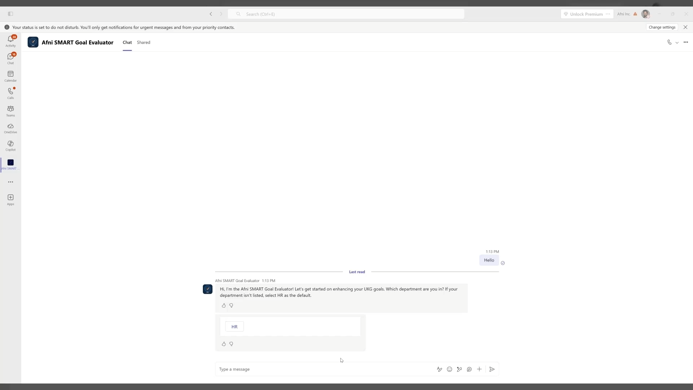
SMART Goal Evaluator Agent in Action

Slide 19
CRITICAL INSIGHT
The Turning Point
What We Tried First
What Actually Worked
Complex enterprise use cases
Heavy integration requirements
Result: Low traction, high friction
Simple, universal use case (goal writing)
Immediate value to every employee
Result: High adoption, built trust
Trust > Complexity
Start simple → Build confidence → Expand to complexity

Slide 20




SUMMARY
Key Takeaways
Start Simple to Build Trust
A universal, low-risk use case drives adoption faster than complex enterprise workflows
Empower Champions Early
Give your best people access and room to experiment — they'll pull others along
Governance Should Enable, Not Block
Lean model: SLT governs, COE controls, Spokes build
Measure Everything
Telemetry, golden datasets, and monitoring from day one — not as an afterthought
Scale with Orchestration
Front-door agent + specialized agents = seamless multi-agent experience

